Slide 1
A Game of choices: student version
By: Adib Thaqif, Andrew Jacobi, Micah Miller, Donald Strong

Slide 2

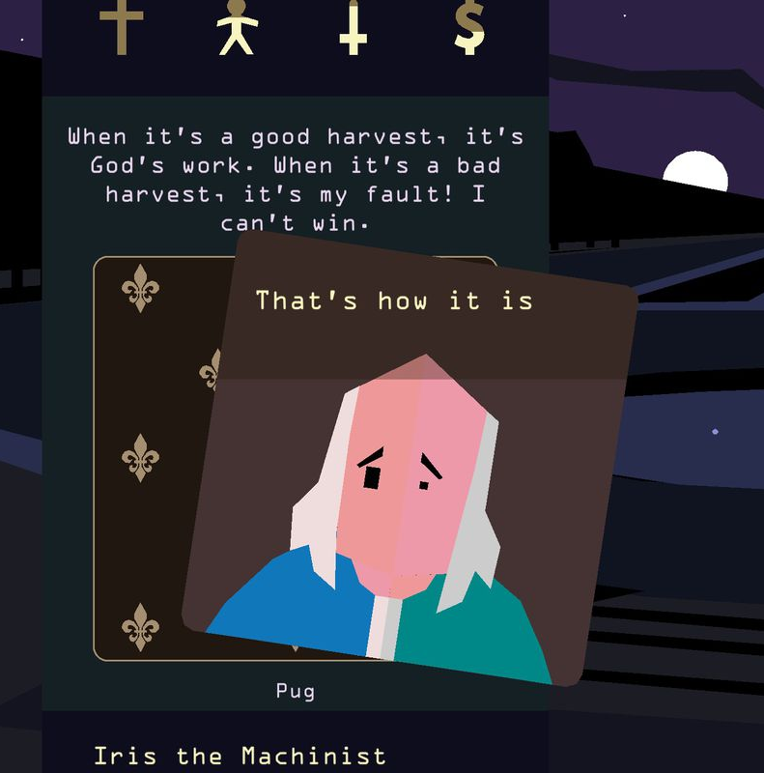

Overview
Inspired by CS145 20 questions & Reigns game
Choice based card game revolving around a typical college student
Purpose: “survive” college years by balancing three aspects: School, Work and Life
Each aspect starts off with 50%.
Constantly choosing one out two choices that affects the aspects (increases or decreases one or more of those aspects)
If one of the aspect values drops below 30% player receives a warning. If it falls below 25%, the game is over! Same goes to if it gets to 75%.

Slide 3
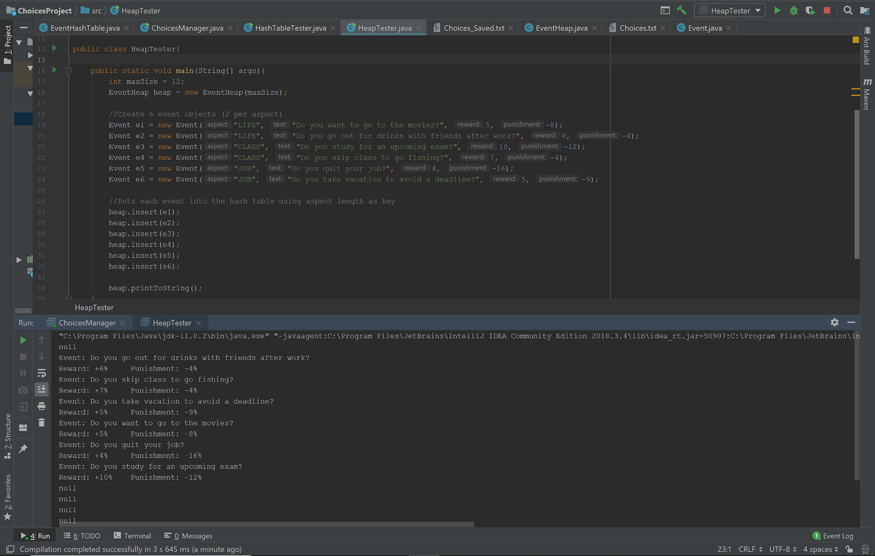
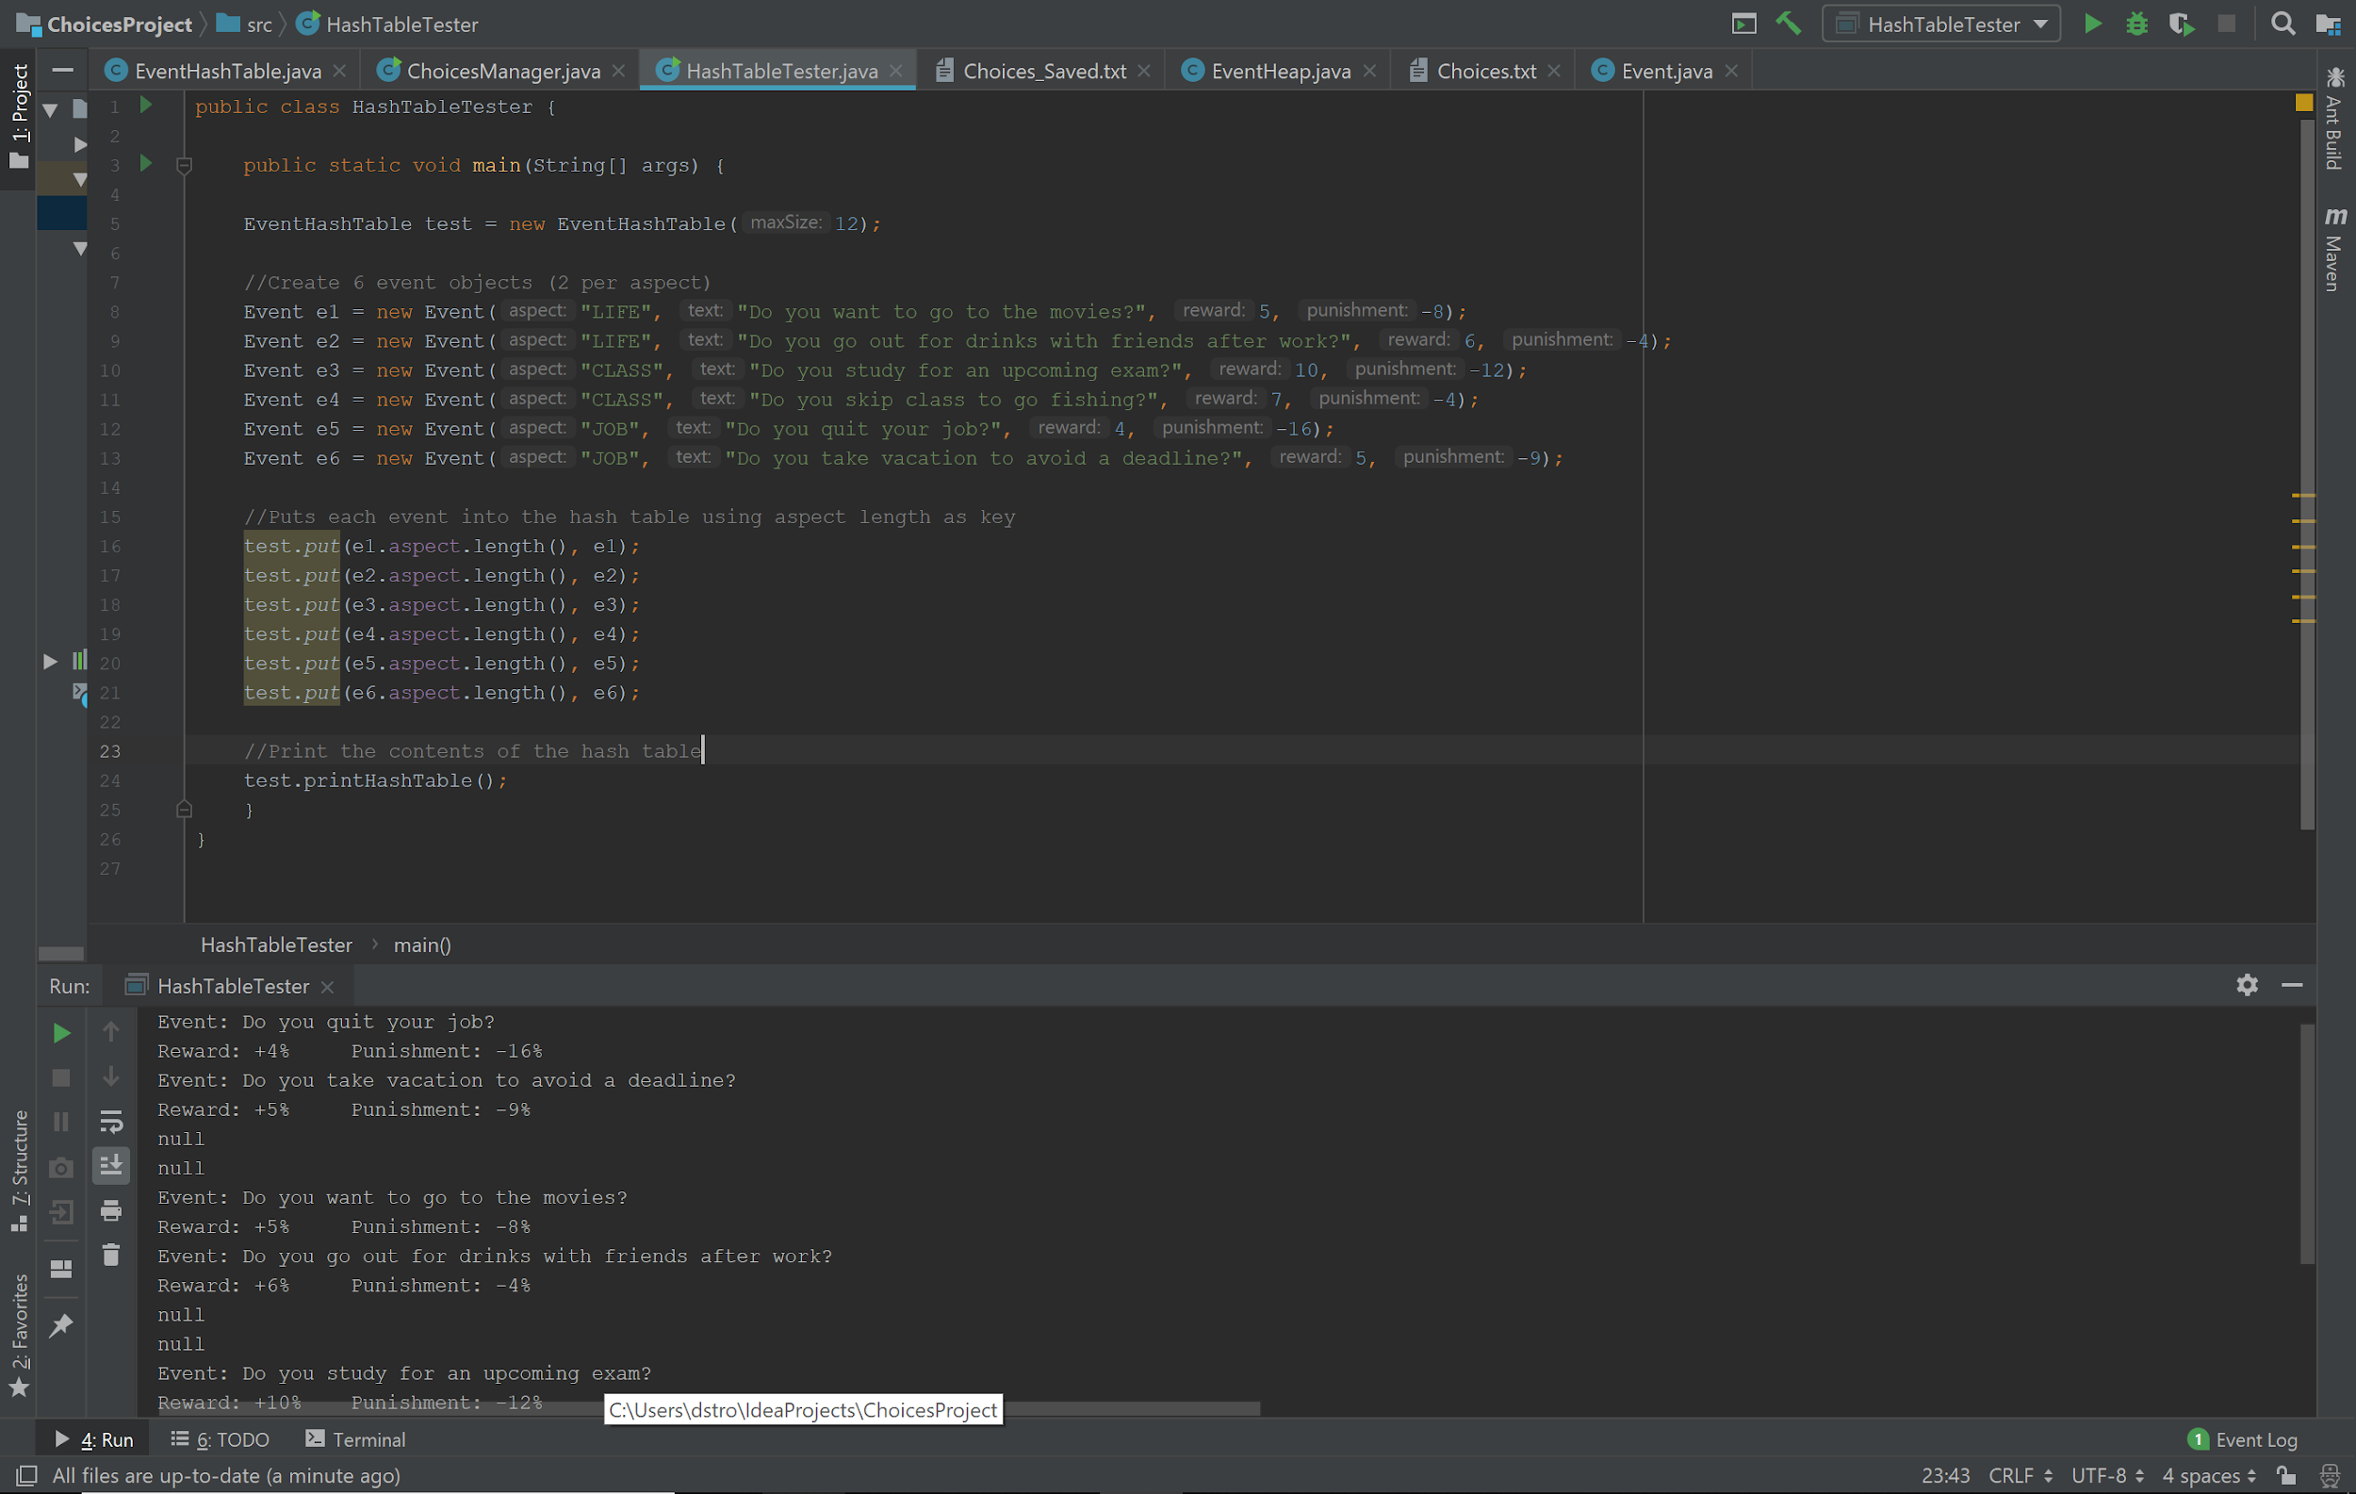
Implementation
Objects:
Event – String aspect, String event, Int reward (pos), int punishment (-)
Data Structures used:
Hashtable – Serves as the “mass storage” for events
Heap – Prioritizes the most beneficial event for the user (least collective impact).

Slide 4
Implementation
Hashtable:
“Mass storage”
Elementary implementation using a single array
Subdivided into three sections
Linear probing collision resolution
get(int key) returns random
Heap:
Prioritizes based on sum of reward and abs(punishment)
Implemented using a single array
deleteMin() returns most beneficial event
Insert(Event e) is called every time deleteMin() to ensure it’s always full

Slide 5
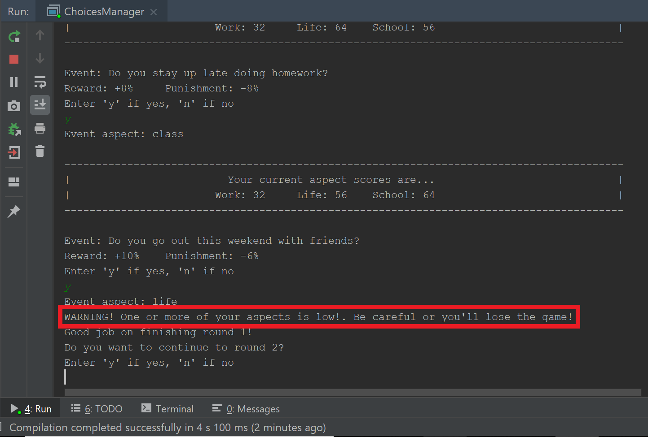
Design Decisions
Event Object:
Each event carried the aspect, text, punishment, and reward information
Read from .txt file
Non-repetitive:
ArrayList graveyard
Compare event from heap to graveyard – working(?)
User Assistance:
Heap prioritization
Warning message
Save/Load
Export current heap to .txt file
Warning

Slide 6
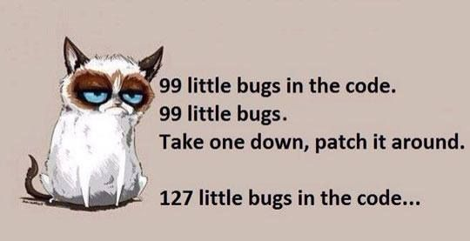
Testing
Hashtable
ArrayIndexOutOfBounds exceptions
Returning null object due to get() being random
- How do we get stuff?!
Heap
Empty heap after calling buildHeap
ArrayIndexOutOfBounds exception when inserting before deleting Min
Save/Load
Does anyone know how to use PrintStream?
Beta Testing
Have people play the game!

Slide 7
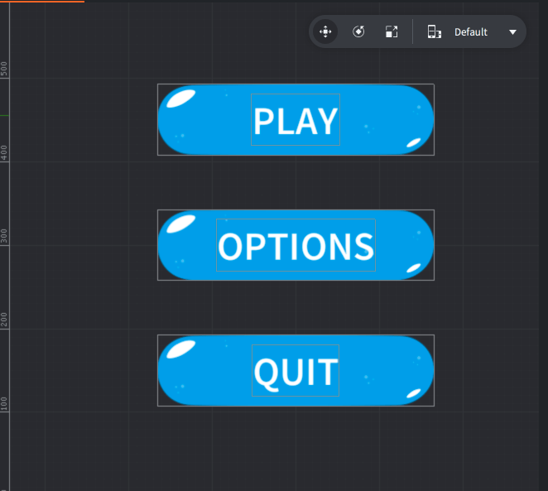


Goals / Future Work
GUI
Hint feature
Allow the User to add Events to the game
Now who would like to play the game?

